Slide 1

RUNGTA COLLEGE OF DENTAL SCIENCES AND RESEARCH
Denture base
Dept of Prosthodontics
3rd Year BDS
Presented By:
Dr.Shilpi Karpathak
Reader
Dept of Prosthodontics

Slide 2
Specific Learning Objective
Core areas | Domain | Category
Introduction Requirements Functions Types a) Plastic b) Metal | Cognitive | Must Know
 | Cognitive | Must Know
Tooth supported partial denture base Distal extension denture base Methods of attaching denture base | Psychomotor | Must Know
Summary | Affective | Must Know

Slide 3
CONTENTS
Definition
Requirements
Functions
Types
a) Plastic
b) Metal
Tooth supported partial denture base
Distal extension denture base
Methods of attaching denture base
Methods of attaching artificial teeth
Relining

Slide 4
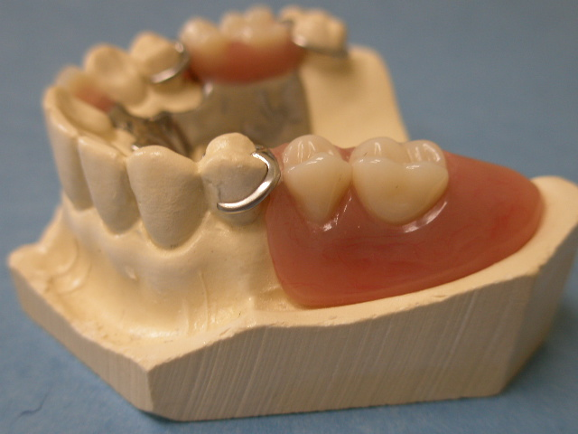
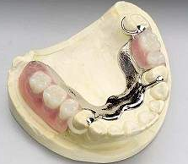
DEFINITION
“Denture base is that part of the removable partial denture which rests on oral mucosa and to which teeth are attached”- GPT8

Slide 5
REQUIREMENTS FOR IDEAL DENTURE BASE
Accuracy of Adaptation To Tissues With Low Volume
Change
Dense non irritating surface capable
of receiving & maintaining a good finish.
Biocompatible
Thermal conductivity
Low specific gravity – Lightness in mouth
Esthetic

Slide 6
Dimensional stability
Sufficient strength – Resistance to fracture
/distortion- Resist deformation
Self cleansing
Low Cost
Potential for future relining

Slide 7
FUNCTIONS
Esthetics
Support and retain artificial teeth
Assist in transfer of occlusal forces directly to abutment teeth through rests.
Prevent vertical and horizontal migration of remaining natural teeth.
Eliminate undesirable food traps.
Stimulates the underlying tissue.

Slide 8
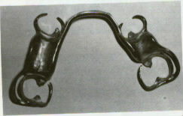
TYPES
Plastic -
      Acrylic
      Polystyrene
      Valplast
Metal -
      Gold
      Co-Cr
      Titanium
      Vitallium

Slide 9
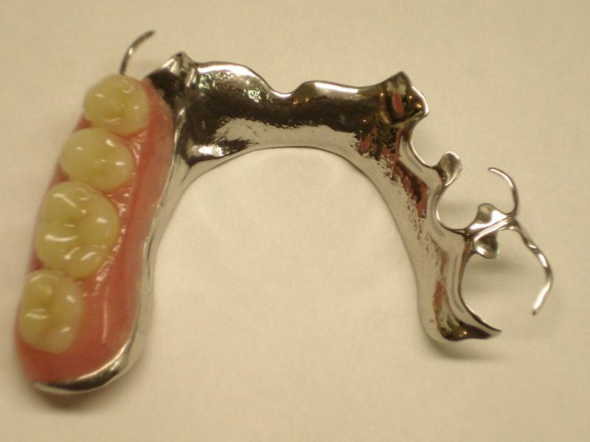
METAL BASE
Indications
Tooth supported partial dentures
Inadequate interarch space
Structural details
Designed with optimum extension
Thinner base than plastic resin
Avoid sharp margins

Slide 10
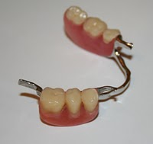
Metal Base - Advantages
Accuracy and Permanence of form
Comparative tissue response
Thermal conductivity
Weight & Bulk

Slide 11
Accuracy and permanence of form
Cast more accurately than denture resins and maintain their accuracy of form without change in mouth.
Need for an additional PPS eliminated entirely
Metal base provides intimacy of contact
retention of denture prostheses.

Slide 12
Comparative tissue response
Metal base naturally cleaner than an acrylic resin base.
Bacteriostatic activity – ionization oxidization of metal base.

Slide 13
Thermal conductivity
Temperature changes transmitted through metal to the underlying tissues help to maintain health of that tissue.
Patient acceptance.
Denture base resins – insulating property

Slide 14
Weight and bulk
Metal alloy may be cast thinner than acrylic resin and still have adequate strength.

Slide 15
Metal Base- Disadvantages
Unaesthetic
Enhancement of retention not possible
Relining difficult
Restoration of normal facial contour can not be achieved

Slide 16
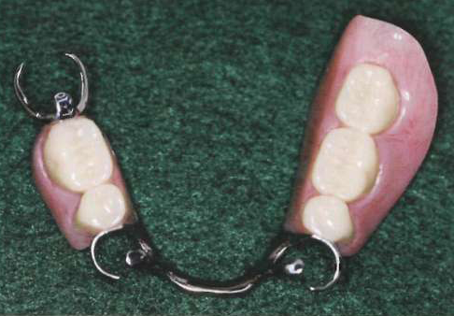
ACRYLIC DENTURE BASE

Slide 17
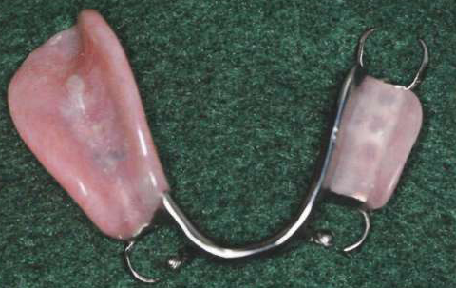
Indications
Extension base partial denture
Long span edentulous ridges
Relining
Contour restoration

Slide 18
Certain situations demands use of acrylic denture base-
  Extreme loss of residual alveolar bone.
  Fullness to denture base to restore facial
contours.
  Esthetics

Slide 19
ACRYLIC DENTURE BASE- STRUCTURAL DETAILS
Adequate bulk & strength- Junction of base & minor connector
Tissue stops at extension base frame work
Placement of Base-
Buccal/ lingual of crest ridge
Placement over crest ridge- Resin Breakage

Slide 20
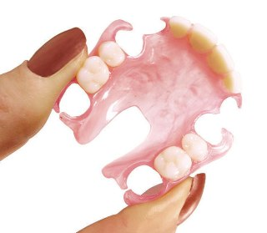
VALPLAST
Flexible denture base
resin ideal for partial dentures.
Esthetics
Functional alternative to traditional cast
metal based removable partial dentures.

Slide 21
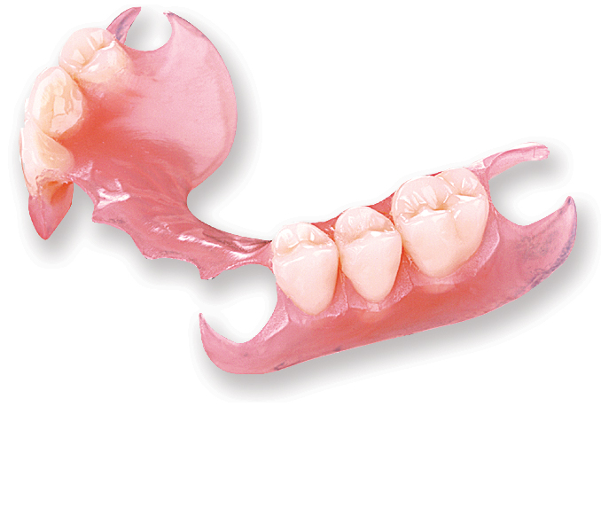
Biocompatible nylon and thermoplastic
resin-flexibility and stability.
Color, shape and design of valplast partials blend with natural appearance of gingiva making prostheses nearly invisible.
Strength of valplast resin doesn’t require a metal framework-eliminates metallic taste.
Enables partial to be fabricated thin enough with non metallic clasps.

Slide 22
Adequate occlusal clearance between arches for tooth placement.
No tooth preparation required
Vitallium combination- Better support & esthetics

Slide 23
DENTURE BASE …..TYPES
Tooth Supported Partial Denture Base
Distal Extension Partial Denture Base

Slide 24
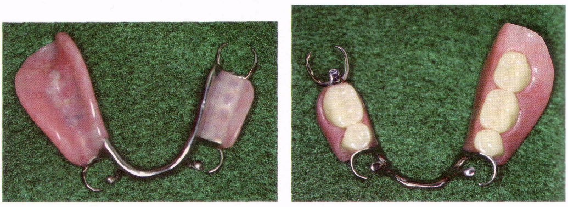
Tooth Supported Partial Denture Base
Denture base is primarily a span b/w two abutments supporting artificial teeth.
Occlusal forces transferred to
abutments-Rests.
Prevent horizontal migration and
vertical migration of natural teeth .

Slide 25
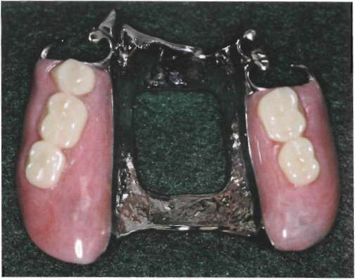
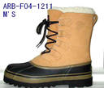
Distal extension partial denture base
Support –primary consideration
Support critical for minimizing
functional movement and
improving prostheses stability.
Snow shoe principle-
Broad coverage furnishes the best support
with least load per unit area is principle
choice for providing max support.

Slide 26
Advantages-
Esthetics
Stimulation of underlying tissue
Relining
Primary retention for RPD –
  Mechanically by placing retaining elements on abutment teeth.

Slide 27
Secondary retention-
Intimate relationship of denture base and major connectors.
Adhesion
Cohesion
Atmospheric pressure
Physiological molding of tissue .
Effect of gravity on mandibular denture.

Slide 28
Methods of attaching denture base
Acrylic resin bases attached to partial denture frame work-minor connector designed b/w framework and underlying tissue.
Relief 20 guage thickness- Basal seat
Plastic mesh patterns in forming retentive framework

Slide 29
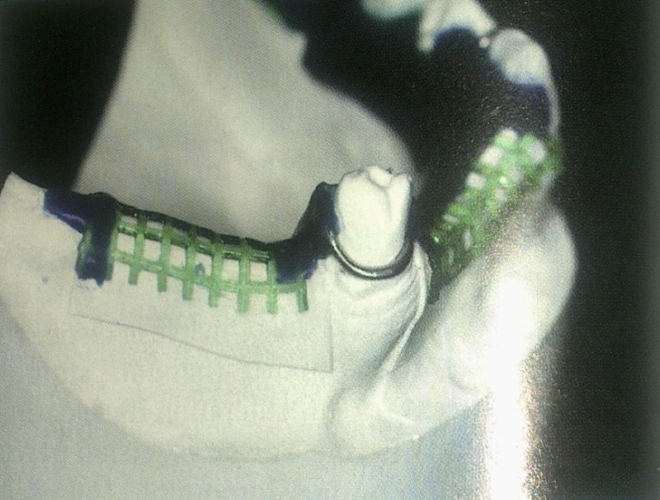
12-14 guage half round wax and 18 guage round wax-ladder like framework rather than mesh pattern.
Designing retentive framework- buccally ligually- strengthen acrylic resin base- minimize distortion of base stress.
Not interfere with teeth arrangement-future adjustment

Slide 30
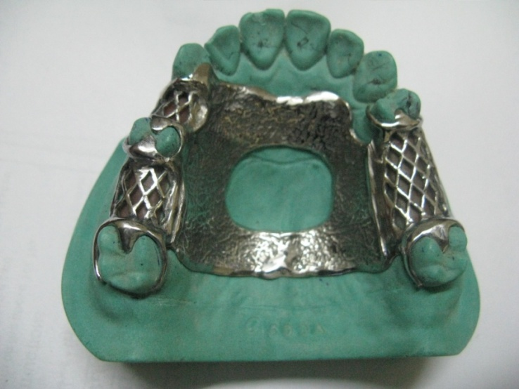
Metal bases- Cast as integral parts of partial denture framework.
Can be assembled & attached to framework with acrylic resin

Slide 31
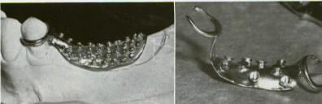
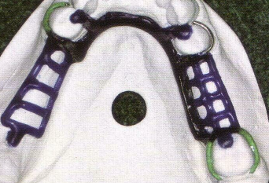
MESH PATTERN/ LADDER
LIKE FRAMEWORK
BEADS & NAIL HEADS

Slide 32
Methods Of Attaching Artificial Teeth
Porcelain/ Resin Artificial Teeth with Resin
Porcelain/ Resin Tube Teeth & Facings Cemented Directly
to Metal Bases
Resin Teeth Processed Directly To Metal Bases
Metal Teeth Cast With Frame Work

Slide 33
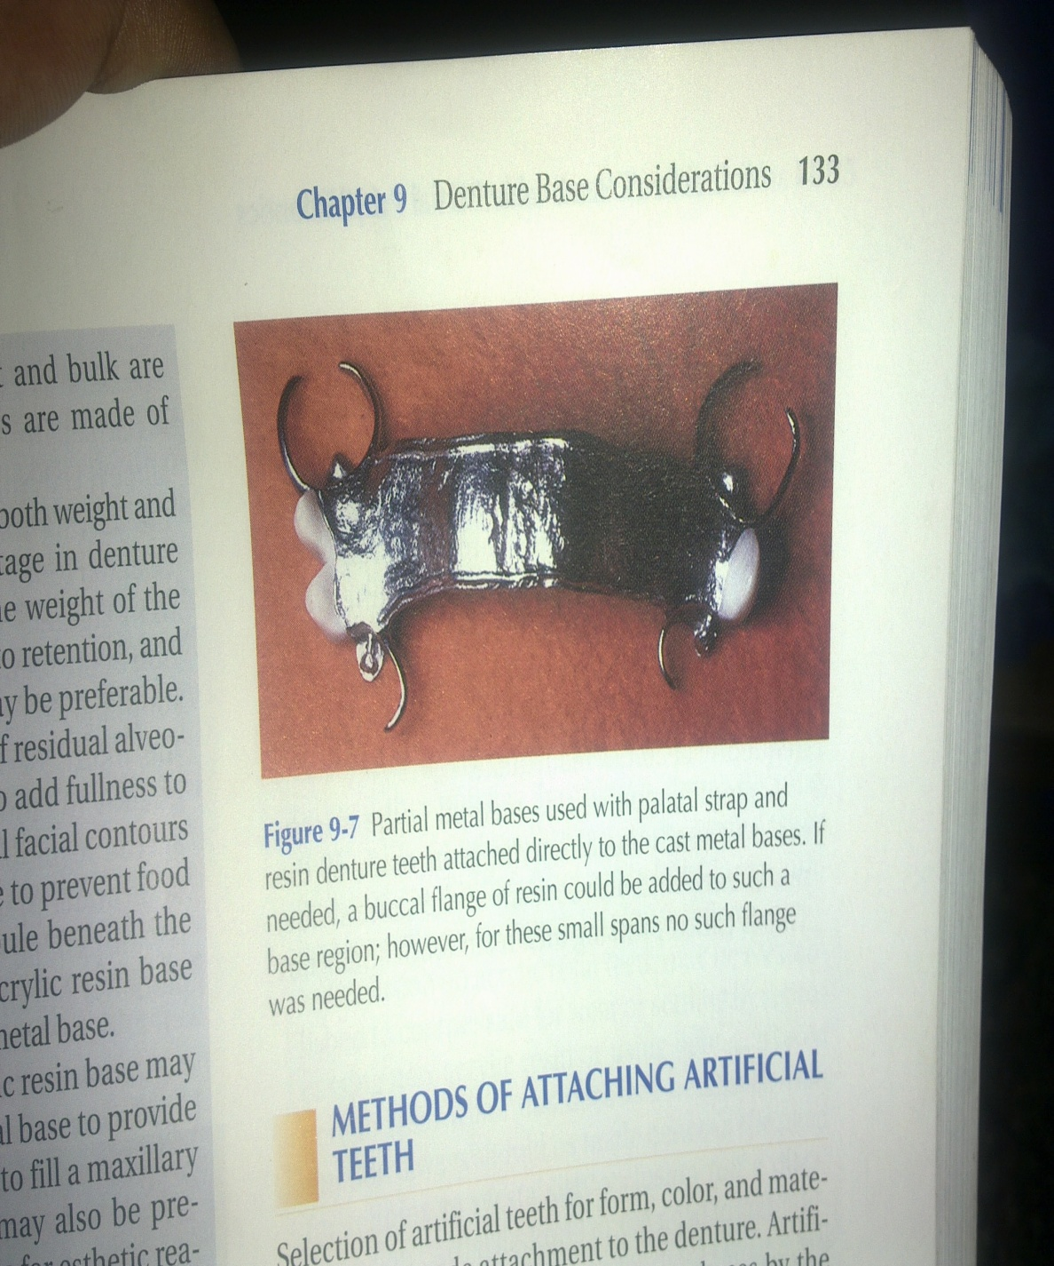
Porcelain or acrylic resin teeth attached with acrylic resin
Porcelain teeth, mechanically
retained by acrylic resin denture
base in their diatoric holes and
retention pins.
Acrylic resin teeth retained by
chemical union with acrylic resin of denture base.

Slide 34
Attachment of acrylic resin to metal base- nail head retention, retention loops or diagonal spurs.
Any junction of acrylic resin with metal should be at an undercut finish line.
Denture odors are frequently caused by accretions at the junction of the acrylic resin with metal.
Separation occurring b/w acrylic resin and metal can lead to loosening of the denture.

Slide 35
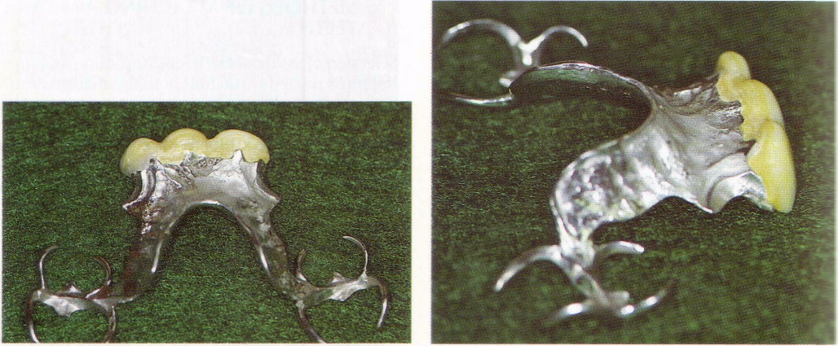
Porcelain or resin tube teeth and facings cemented directly to metal bases.
Modification of this method is attachment of ready made acrylic resin teeth to the metal base with acrylic resin of same shade(pressing).
Particularly applicable for ant replacements.

Slide 36
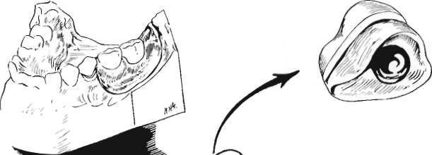
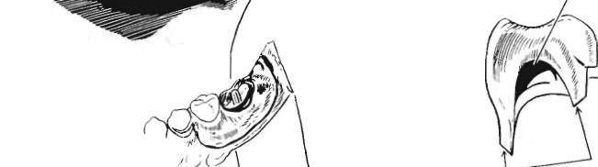

Slide 37
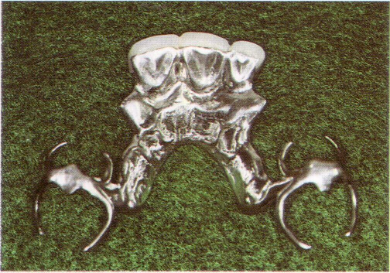
Disadvantages
Difficulties in obtaining satisfactory occlusion.
Lack of adequate contours for functional tongue and cheek contact.
Unesthetic display of metal at gingival margins.

Slide 38
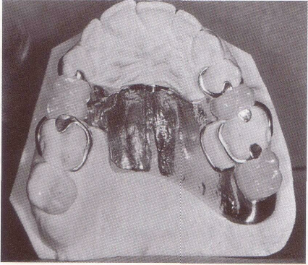
Resin teeth processed directly to metal bases
Occlusal relation established in
mouth and transferred to articulator.
Teeth can be carved or processed
in acrylic resin of proper shade.
Long, short,wide or narrow teeth may be created when necessary to fill spaces.

Slide 39
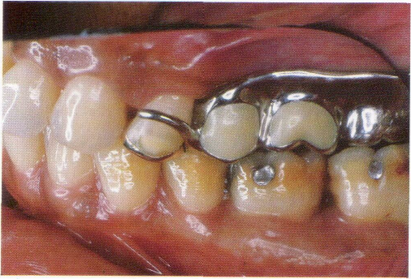
METAL TEETH
Occasionally a second molar tooth may be replaced as part of partial denture casting.
Space too limited for attachment of an artificial tooth.
Should be used only to fill a space and to prevent tooth extrusion.

Slide 40
CHEMICAL BONDING
Recent developments- direct chemical bonding of acrylic resin to metal frame.
Investing alveolar & gingival tissue replacement components can be attached without the use of loops, mesh or surface mechanical locks.
Section of metal framework- roughened with abrasives- Treated with vaporised silica
Acrylic resin bonding agent is then applied.

Slide 41
Triochemical coating accomplishes a second method of fusing a microscopic layer of ceramic to metal.
Sandblasting metal framework with silica particles.
Silane added to ceramic- Chemical bond between silicate layer & denture base acrylic resin.
Denture base acrylic resins formulated with 4- Meta are also available & provide mechanism of bonding acrylic resin to metal.

Slide 42
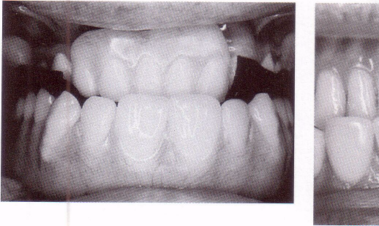
NEED FOR RELINING
Distal extension base differs from tooth supported base-
  made of material
  relined.
Acrylic resin denture base materials that can be relined are generally used.

Slide 43
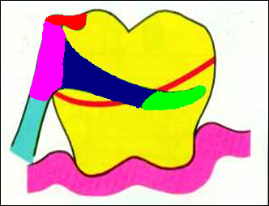
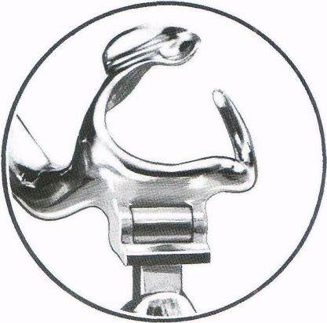
STRESS - BREAKERS
In distal extension situations-rigid connection b/w denture base and supporting teeth account for the base movement without causing tooth or tissue damage.
Two types of stress breaking design.
    Tapered, wrought wire retentive clasp-flexibility.
    stress breaking-separating action of retaining elements from denture base

Slide 44
2 types of clasp assembly-
Retentive clasp arms- engage undercuts on abutment tooth- tissue ward movement- min leverage to the abutment
Tapered, Wrought wire retentive clasp- Flexibility
Act as stress breaker between denture base & abutment tooth.

Slide 45
summary
The components parts of the cast partial denture perform specific roles in providing retention,stability and support for the prosthesis.
Their judicious use also helps to preserve the health of the tissues.
Except the indirect retainer , all the other components are an integral part of almost every cast partial denture.
Hence,the role of each compoents should be thoroughly understood to help design the partial denture for different clinical situations

Slide 46
Take home message
The components parts of the cast partial denture perform specific roles in providing retention,stability and support for the prosthesis.
Their judicious use also helps to preserve the health of the tissues.
Except the indirect retainer , all the other components are an integral part of almost every cast partial denture.

Slide 47
References
Removable partial prosthodontics 11th edition Mc cracken
Clinical removable partial prosthodontics stewarts
A color atlas of removable partial dentures J.C. Davenport ; R.M. Basker
Advanced Removable Partial Dentures James S. Brudvik
Arthur M. LaVere, and Arthur J. Krol, Selection of a maior connector for the extension-base removable partial denture JPD 1973;30,102-105
Davis Hendersonand Thomas E. Seward Design and force distribution with removable partial dentures: A progress report JPD 1967;17,350-364.

